Slide 1
CSE 842 NLP PyTorch Practical Class
Chen Zheng, Parisa Kordjamshidi
{zhengc12, kordjams}@msu.edu
Michigan State University
Computer Science and Engineering Department

Slide 2
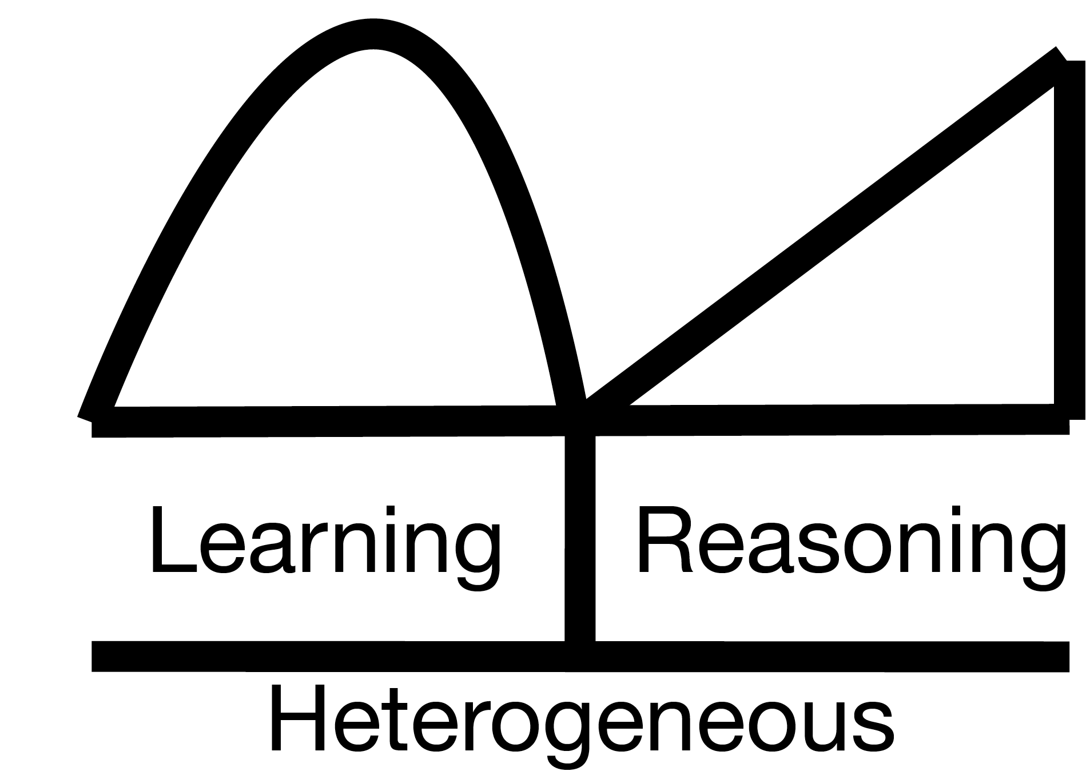
CSE 842 NLP PyTorch Practical Class
Warm Up (Linear Regression)
Multi-Layer Perceptron (MLP) on Sentiment Analysis
Convolutional Neural Network (CNN) on Sentiment Analysis (optional)
Transformer Architecture on Reading Comprehension
Recurrent Neural Network (RNN) on Sequence Tagging
Recommendation: AllenNLP Library (optional)

Slide 3
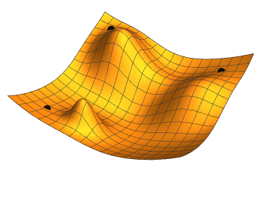
Warm Up (Linear Regression)
Task 1:
Input: Randomly generating 5 (x, y) data points from the Ground-Truth Weight.
Weight w: 1-D tensor w
Loss function: Mean Squared Error.
Compute the derivative.
Find the weight w that minimizes Mean Squared Error.
Task 2:
Input: Randomly generating 100 (x, y) data points.
Weight w: 5-D tensor [w1, w2, w3, w4, w5]
Loss function: Mean Squared Error.
Compute the derivative.
Find the weights [w1, w2, w3, w4, w5] that minimizes Mean Squared Error.

Slide 4
Warm Up (Linear Regression )
Task 2:
Input: Randomly generating 100 (x, y) data points from the Ground-Truth Weight.
Learning Weight w: 5-D tensor [w1, w2, w3, w4, w5].
Loss function: Mean Squared Error.
Gradient Descent Optimizer.
Find the weights [w1, w2, w3, w4, w5] that minimize Mean Squared Error.
Task 3:
Input: Natural Language Processing: (sentence, positive/negative) data points.
Weight W: high dimensional tensor.
Loss function: Mean Squared Error → Cross Entropy Loss.
Gradient Descent Optimizer → Adam Optimizer.
Use PyTorch Library!

Slide 5
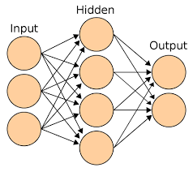
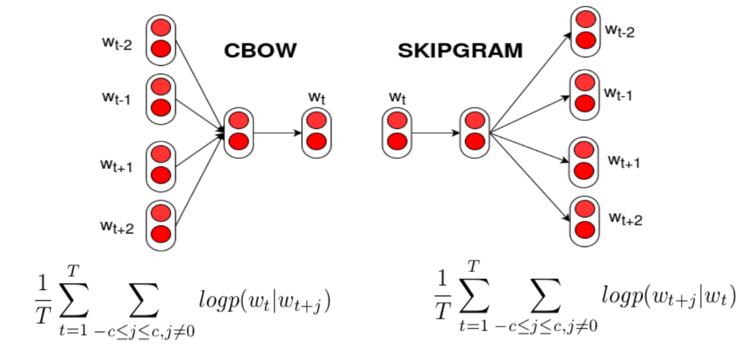
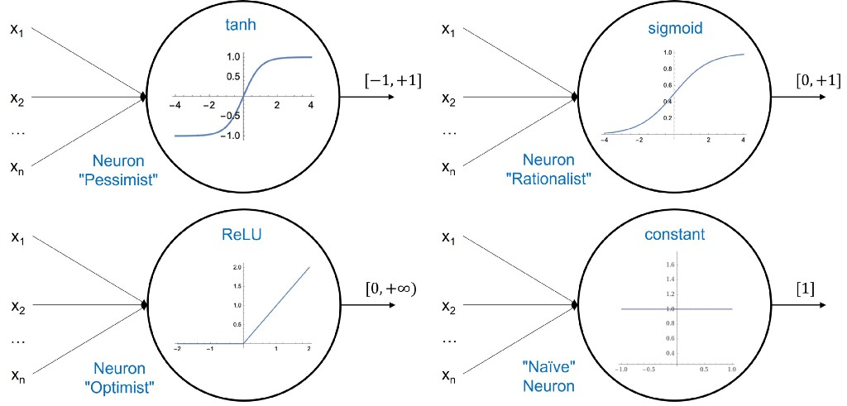
Multi-Layer Perceptron (MLP) on Sentiment Analysis
PyTorch Task:
Input: Natural Language Processing: (sentence, positive/negative) data points.
Learning Weight W: high dimensional tensor
2-Layer MLP.
Activation Function (Linear -> Non-Linear)
Word Representation: Glove.
Loss function: Cross Entropy Loss
Gradient Descent Optimizer → Adam Optimizer.
GPU.

Slide 6
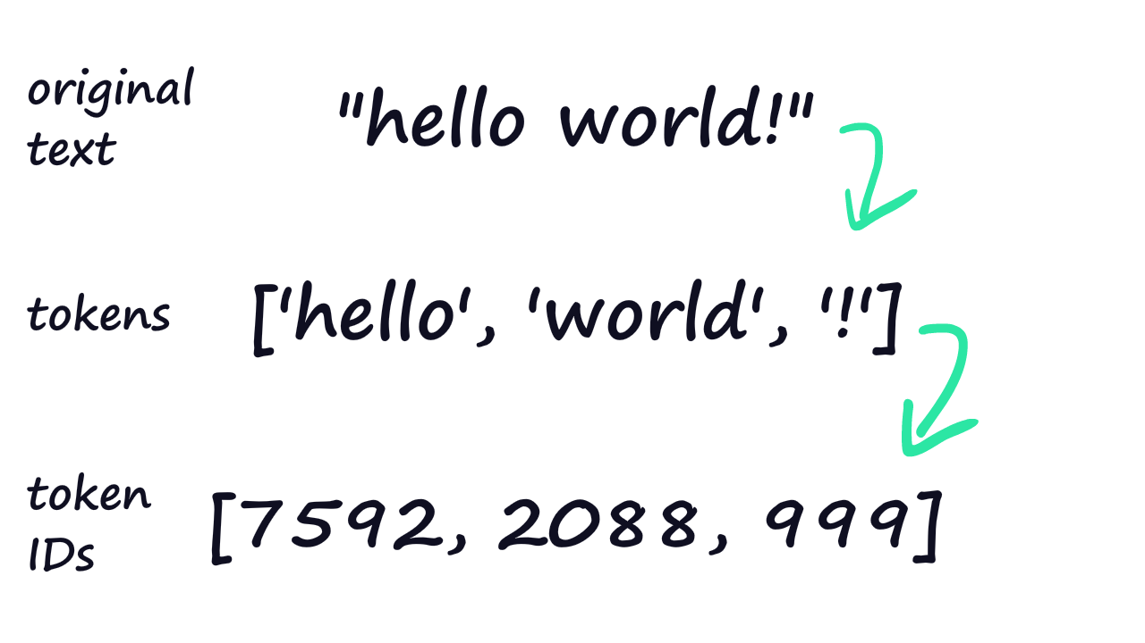
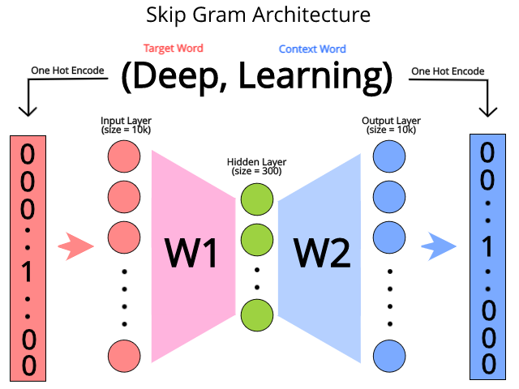
Multi-Layer Perceptron (MLP) on Sentiment Analysis
PyTorch Task:
Input: Natural Language Processing: (sentence, positive/negative) data points.
Learning Weight W: high dimensional tensor
2-Layer MLP.
Activation Function (Linear -> Non-Linear)
Word Representation: Glove.
Loss function: Cross Entropy Loss
Gradient Descent Optimizer → Adam Optimizer.
GPU.

Slide 7

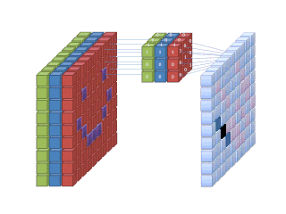
Convolutional Neural Network on Sentiment Analysis (optional)
PyTorch Task:
Input: Natural Language Processing: (sentence, positive/negative) data points.
Weight W: large-scale dimensional tensor
Convolutional Neural Network.
Activation Function (Linear -> Non-Linear)
Dropout.
Loss function: Cross Entropy Loss
Gradient Descent Optimizer → Adam Optimizer.
GPU.

Slide 8
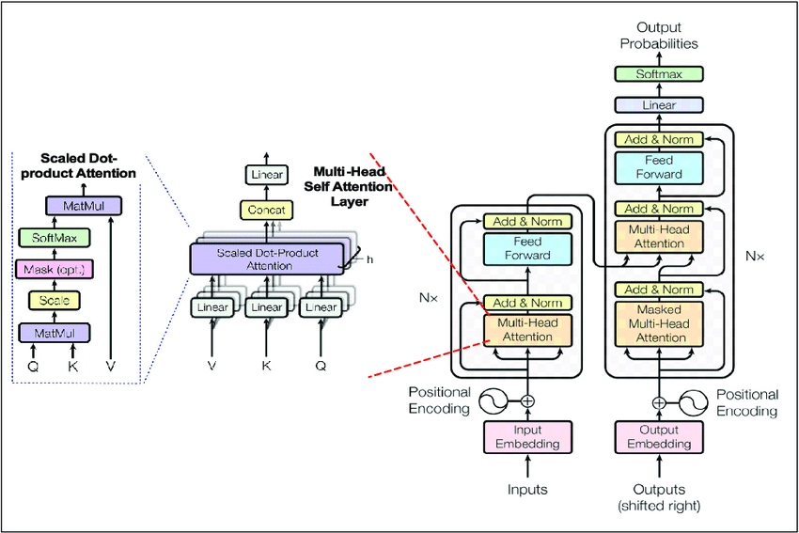

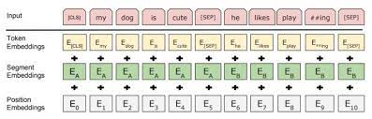
Transformer Architecture on Reading Comprehension
PyTorch Task:
Input: Natural Language Processing: (question, paragraph, answer) Triplet.
Transformer Architecture.
Pretrained-BERT.
Hugging-face Library.
GPU.

Slide 9

Recurrent Neural Network on Sequence Tagging
PyTorch Task:
Input: Natural Language Processing: (sentence, sequence tagging).
Weight W: large-scale dimensional tensor
Recurrent Neural Network.
Activation Function (Linear -> Non-Linear)
Loss function: Cross Entropy Loss
Adam Optimizer.
GPU.

Slide 10
Thank you!

